Slide 1
PCHH – Azara Data Project Overview
June 2017

Slide 2
Agenda
What is Medicaid?
What is PCHH/Integrated Care?
Why does the PCHH program require OCH to submit data?
Who does OCH submit the data to?
How does Azara use OCH data?
Azara Scorecard Example
How is the data captured, analyzed, and submitted?
Project Status as of 6/21/17 and goals to be accomplished by 8/21/17
Project challenges
Plans to overcome challenges and achieve goals
Notes:
Kathy B

Slide 3
What is Medicaid?
Medicaid is a jointly funded, Federal-State health insurance program for low-income and needy people. It covers children, the aged, blind, and/or disabled and other people who are eligible to receive federally assisted income maintenance payments.

Slide 4
What is PCHH/Integrated Care?
Primary Care Health Home (PCHH) is a Medicaid program that strives to provide intensive care coordination and care management as well as address social determinants of health for a medically complex population. One aspect of the program includes the implementation and evaluation of the Patient Centered Medical Home (PCMH) model as a means to:
achieve accessible, high quality primary care;
demonstrate cost-effectiveness in order to validate and support the sustainability and spread of the model, and
support primary care practices by increasing available resources and improving care coordination thus improving the quality of clinician work life and patient outcomes.
OCH’s Integrated Care department was created as a means to participate in the PCHH program

Slide 5
Why Does the PCHH Program Require OCH to submit data?
Generally speaking, the Medicaid program collects data on Medicaid patients for a variety of reasons, including to inform key program decisions.
OCH submits data for all outpatient primary care patients seen at an OCH primary care site participating in the PCHH program that Medicaid is a payer (primary or secondary).
This data is used to help evaluate the effectiveness of the PCHH program as well as provide a comparison between programs at different health care systems.

Slide 6
Who does OCH submit the data to?
Azara Healthcare is the third-party provider of data reporting and analytics.
Azara’s solutions empower Primary Care Associations to improve quality and efficiency in all aspects of their care delivery through actionable data.

Slide 7
How Does Azara use OCH Data?
Azara receives data for OCH’s entire* Medicaid population
That large dataset is then filtered down to capture only the Medicaid patients in the PCHH program
Using the filtered data, Azara generates a scorecard which comprises 23 measures as of 6/21/17
These measures currently do not affect reimbursement, but could potentially in the future
* Some restrictions apply (e.g., the visit must be a qualifying visit at a site participating in the PCHH program)

Slide 8
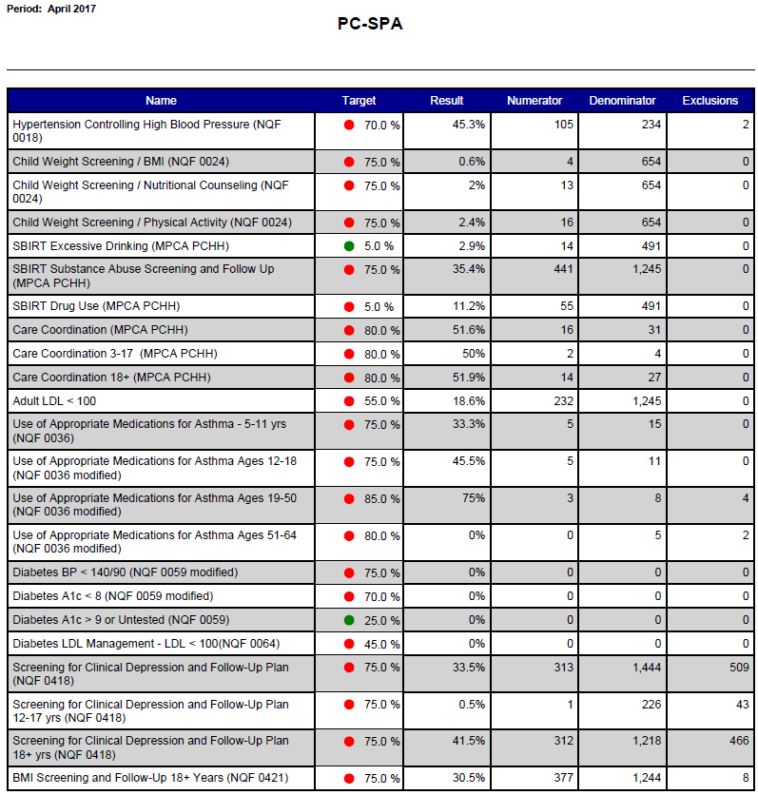
Azara Score Card Example

Slide 9
How is the Data currently Captured, Analyzed, and Submitted?
OCH uses Evident software for patient accounting, inventory tracking, data storage/reporting, and a variety of other purposes. Most of the PCHH data is stored in this system.
The Azara data is currently extracted from 4 Evident modules using ad-hoc reports
Evident modules (AKA, facilities) include: 01, 33, 38, and 46
In-house databases designed specifically for Integrated Care contain additional information not stored in Evident (such as monthly touches). However, this information is not used for reporting.
Once extracted, the data is saved in MS Excel to later be imported into MS Access for manipulation.
Once processed in MS Access, the data is then exported to XML files and submitted to Azara using FileZilla, a software for transferring files over the internet.
FlySpeed is a newly acquired database tool expected to improve efficiency by enabling data extraction from all four Evident modules simultaneously rather than the current method of extracting data from one module at a time.

Slide 10
Project Status as of 6/21/17 and Goals to be Accomplished by 8/21/17
OCH’s current data generator (MS Access) tools have undergone major modifications in April 2017. All data from 1/1/16 – 4/30/17 has been resubmitted to Azara with a new primary key system.
The resubmitted data was reported to Azara before OCH was provided the Azara value sets (e.g., which CPT codes determine a qualifying encounter, which diagnosis codes determine a qualifying diagnosis, etc.).
The Azara value sets were made available to OCH on 6/19/17. Future report generators should capture and report data that is compatible with those value sets.
The OCH data team built an in-house Scorecard generator that provides the numerators, denominators, and exclusions to calculate results for each of the Scorecard measures. The OCH scorecards and Azara scorecards are currently producing conflicting results. Objectives include improving the accuracy of OCH’s scorecard generator as well as increasing predictive reporting capabilities.
Our data should reflect the level of quality care that our PCHH program provides. The overall goal is to improve the Azara data collection, analysis, and reporting process and ultimately improve the Azara Scorecard results.

Slide 11
Project Challenges
Not all clinics enrolled in the PCHH program maintain patient records electronically. The data is only stored in a paper chart, and thus is excluded from the data submitted to Azara
The Evident software creates a host of difficulties/inefficiencies
Not all data elements can be extracted on an Evident ad hoc report
Each ad hoc report is limited regarding the data elements it can include
This requires extra steps to link the tables in MS Access. The tables often lack the necessary primary and foreign keys
Because four separate Evident modules contain relevant data, the ad hoc reports must be pulled four times each (once for each module)
Each module uses a unique coding system. For example, item numbers, insurance codes, department codes, etc. vary across modules. Resultantly, each code must be translated by module. This requires continual maintenance of four dictionaries for each code for each module because the codes are continually updated in Evident.
Azara Scorecard results seem inaccurate
Include patients not in the PCHH program
Include other data errors such as incorrect patient MRN numbers, incorrectly diagnosing patients, etc.

Slide 12
Plans to Overcome Challenges and Achieve Goals
Option 1: Utilize new-to-OCH, sophisticated data software (e.g., RStudio) that can reduce the time requirements of the data collection and reporting process as well as produce more accurate reports
Option 2: Continue using current data software (MS Access), but improve using the newly acquired Azara value sets
Both options could be enhanced by utilizing the newly acquired FlySpeed software to extract data from Evident more efficiently.
Both options include employing an OCH in-house Scorecard generator to calculate measure results and provide predictive reports identifying patients that will be due for a particular healthcare service in the near future.
Coordinate with Azara to resolve the apparent inaccuracies in their scorecard results

